Slide 1
Model Appropriateness
Introduction

Slide 2
Check for Model Appropriateness
Purpose of this unit:
In previous units we have learned about a variety of useful time series models, how to fit these models to data, etc.
In this unit, we will step back and take a closer look at the model(s) we have fit to a set of data to ascertain whether the models appear to be appropriate
And are not simply the best we’ve been able to do so far
Things to consider include
Whether basic assumptions of the models are satisfied
Ramifications of selecting certain models
Forecasting performance (we’ve already looked at this)

Slide 4
White Noise Review

Slide 5
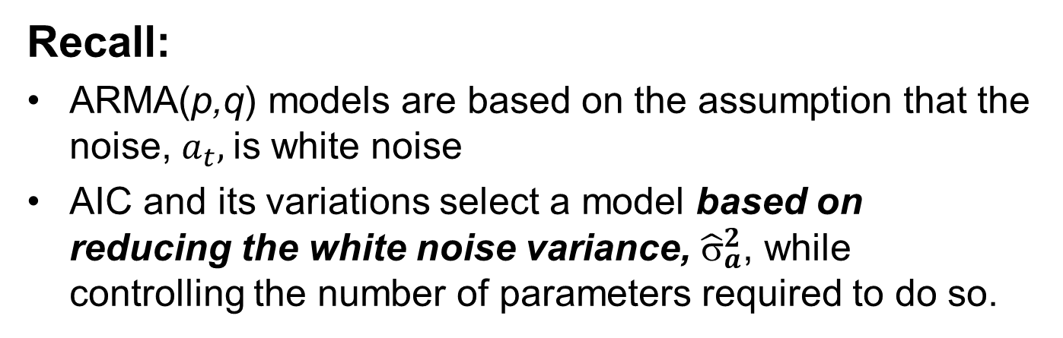
Check for Model Appropriateness
Does the model “whiten” the residuals?
Recall:
ARMA(p,q) models are based on the assumption that the noise, $a_{t},$is white noise
AIC and its variations select a model based on reducing the white noise variance, ${\hat{σ}}_{a}^{2}$, while controlling the number of parameters required to do so.

Slide 6
Checking Residuals for White Noise
Key point:
$avar is actually a “residual” variance and does not measure whether or not the residuals are white noise.
Notes:
If the residuals are not white noise, this suggests that further modeling may be necessary to better explain the behavior in the data.
The residuals are calculated within the functions est.ar.wge and est.arma.wge and found in the output variable $res.
We briefly discuss calculation of the residuals next.

Slide 8
Calculating Residuals

Slide 9
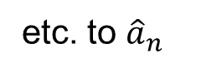
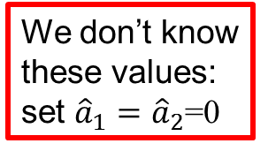
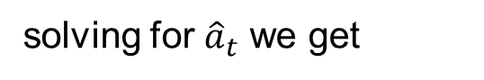
Calculating Residuals
Suppose we have fit the following ARMA(p,q) model to a realization.
solving for ${\hat{a}}_{t}$ we get
Light Board
Assuming for simplicity that p=2 and q=1, we have
So,
We don’t know these values: set ${\hat{a}}_{1}={\hat{a}}_{2}$=0
------------------------------------------------------------------------------------
=0
etc. to ${\hat{a}}_{n}$

Slide 11
Comments on Calculating the Residuals

Slide 12
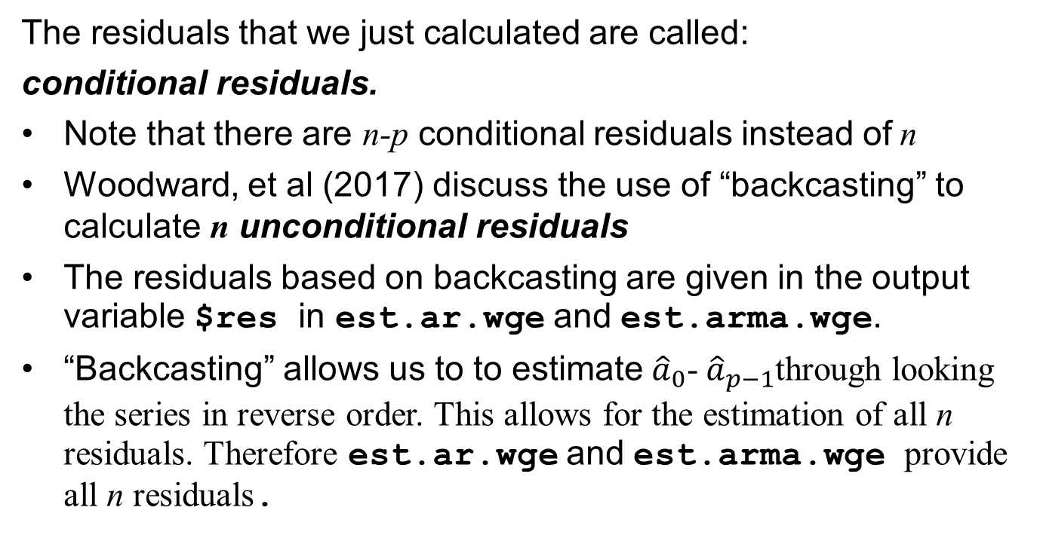
Comments on Calculating Residuals
The residuals that we just calculated are called:
conditional residuals.
Note that there are n-p conditional residuals instead of n
Woodward, et al (2017) discuss the use of “backcasting” to calculate n unconditional residuals
The residuals based on backcasting are given in the output variable $res in est.ar.wge and est.arma.wge.
“Backcasting” allows us to to estimate${\hat{a}}_{0}$- ${\hat{a}}_{p−1}$through looking the series in reverse order. This allows for the estimation of all n residuals. Therefore est.ar.wge and est.arma.wge provide all n residuals.

Slide 14
Testing Residuals for White Noise
Visual

Slide 15
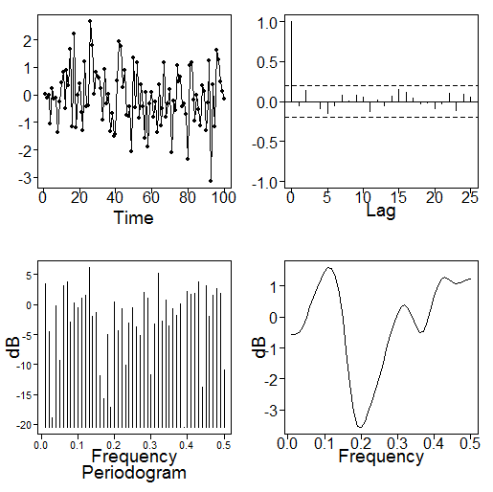
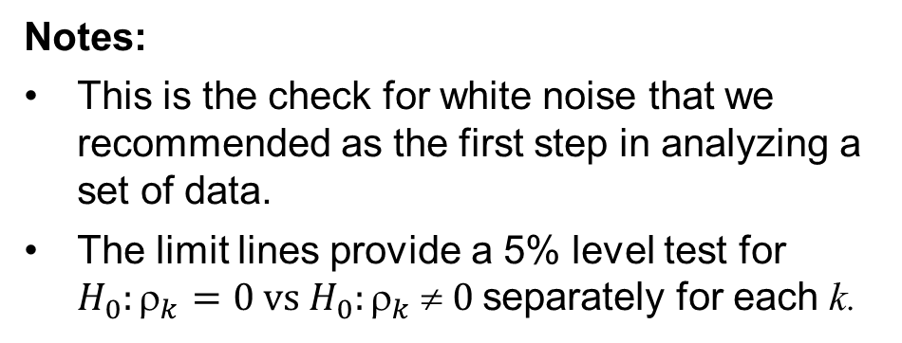
Testing Residuals for White Noise
We will focus on two methods for checking the residuals for white noise.
Check 1: Visually inspect plots of the residuals and their sample autocorrelations
The residuals should look like white noise (random)
About 95% of the sample autocorrelations of the residuals should stay within the limit lines.
They don’t do it here, but with white noise we expect about 1 in 20 observations to randomly fall outside the limits. (5%)
Notes:
This is the check for white noise that we recommended as the first step in analyzing a set of data.
The limit lines provide a 5% level test for $H_{0}:_{k}=0 vs H_{0}:_{k}  0$separately for each k.

Slide 17
Testing Residuals for White Noise
Ljung-Box

Slide 18
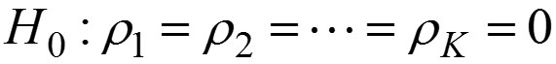
Testing Residuals for White Noise
Check 2: Ljung-Box test
Whereas checking the limit lines apply separately to each lag k, Ljung-Box tests the hypothesis
The Ljung-Box test is referred to as a portmanteau [port man tō] test
“Portmanteau” is a seldom-used word that can mean “embodying several uses or qualities”
Ljung-Box tests the autocorrelations as a group

Slide 19
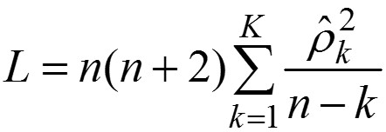
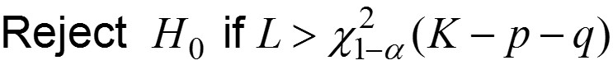
Ljung-Box Test
The Ljung-Box test statistic for testing the null hypothesis:
is
It is advisable to check more than one value of K
Box and Jenkins use K=24 and 48
tswge function ljung.wge
ljung.wge(res,p,q,K)
# res residual file
# after ARMA(p,q) fit to data
# K is capital K above (default=24)

Slide 21
Example 1
ARMA(2,1)

Slide 22
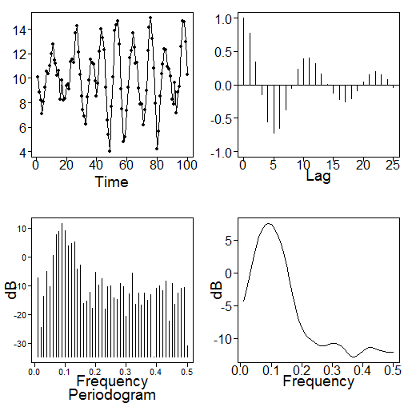
Example: ARMA(2,1)
Recall: Realization from ARMA(2,1):
# generate the realization from ARMA(2,1)examined earlier
x=gen.arma.wge(n=100,phi=c(1.6,-.9),theta=.8,sn=67)
x=x+10
plotts.sample.wge(x)
Realization
Sample autocorrelations
These seem to indicate stationarity
Sample autocorrelations damp quickly

Slide 23
Example: ARMA(2,1)
aic.wge(x,p=0:8,q=0:4)
# AIC picks ARMA(2,1)
x21=est.arma.wge(x,p=2,q=1)
# x21$phi: 1.6194830 -0.9131788
# x21$theta: 0.868127
# x21$vara: 1.076196
mean(x) # 10.07557
Final model we found in estimation unit
Next we examine the residuals
# x21$res: Contains residuals from the ARMA(2,1) fit

Slide 24
Residual Analysis: ARMA(2,1) Example
Check 1: Examine plots of residuals and their sample autocorrelations
Residual sample autocorrelations with 95% limit lines
Residuals (x21$res)
Residuals look “white”
Residual sample autocorrelations within 95% limit lines

Slide 25
Residual Analysis: ARMA(2,1) Example
Check 2: Ljung-Box test
ljung.wge(x21$res,p=2,q=1)
# $K: 24 (default)
# $chi.square: 20.92251
# $df: 21
# $pval: 0.4636851
ljung.wge(x21$res,p=2,q=1,K=48)
# $K: 48
# $chi.square: 44.93891
# $df: 45
# $pval: 0.4636851
For both K=24 and 48 we fail to reject white noise
Based on Checks 1 and 2 the residuals from the fitted ARMA(2,1) model seem to be white.

Slide 27
Example 2
Seasonal (1-B¹²)

Slide 28
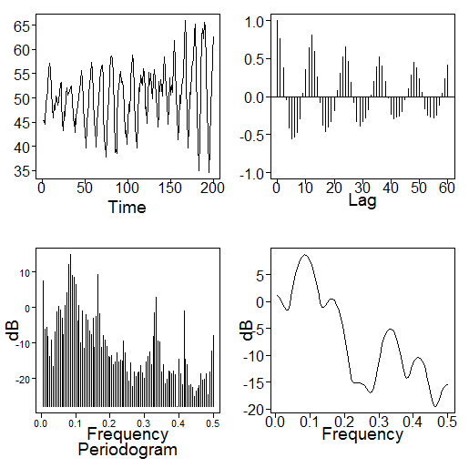

Simulated Seasonal Data Analyzed Earlier
$$(1−B^{12})\left(1−1.5B+.8B^{2}\right)\left(X_{t}−50\right)=a_{t}$$
Realization
Sample autocorrelation
tswge code to simulate and plot the data above
x=gen.aruma.wge(n=200,s=12,phi=c(1.5,-.8),sn=87)
x=x+50
plotts.sample.wge(x,lag.max=60)

Slide 29
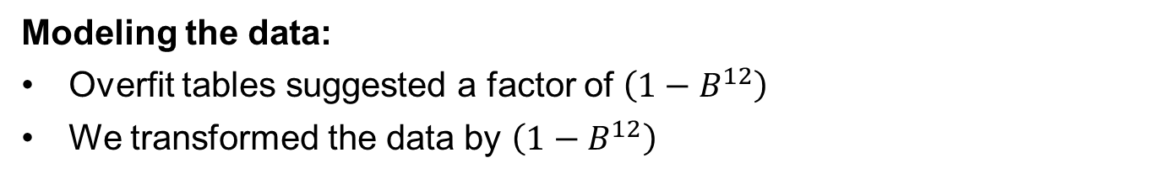
Simulated Seasonal Data Analyzed Earlier
$$(1−B^{12})\left(1−1.5B+.8B^{2}\right)\left(X_{t}−50\right)=a_{t}$$
Modeling the data:
Overfit tables suggested a factor of $\left(1−B^{12}\right)$
We transformed the data by $\left(1−B^{12}\right)$
y=artrans.wge(x,phi.tr=c(0,0,0,0,0,0,0,0,0,0,0,1))
Transformed data appeared to be stationary
After transforming the data we used BIC which selected an AR(2) model
est.y=est.ar.wge(y,p=2)
And obtained the fitted model
$(1−B^{12})\left(1−1.47B+.76B^{2}\right)\left(X_{t}−49.78\right)=a_{t}$ ${\hat{σ}}_{a}^{2}=1.04$
How about the residuals?

Slide 30
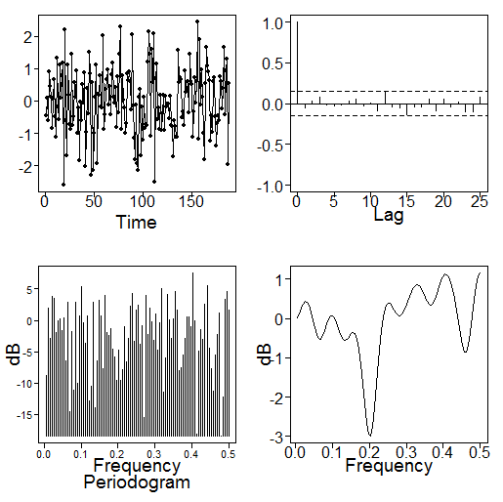
Simulated Seasonal Data Analyzed Earlier
The residuals are in est.y$res
Check 1: Examine plots of residuals and their sample autocorrelations
Residual sample autocorrelations with 95% limit lines
Residuals (est.y$res)
Residuals look “white”
Residual sample autocorrelations within 95% limit lines

Slide 31
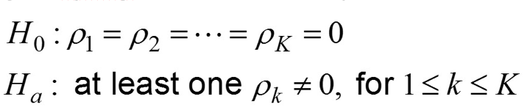
Simulated Seasonal Data Analyzed Earlier
Check 2: Ljung-Box test
Recall: When we fit an ARIMA or Seasonal Model, we transform the data to stationarity. The p and q in the Ljung-Box call statement are for the estimation of the stationary component. (in this case p=2)
ljung.wge(est.y$res,p=2)
# $K: 24 (default)
# $chi.square: 20.95537
# $df: 22
# $pval: 0.5234977
ljung.wge(est.y$res,p=2,K=48)
# $K: 48
# $chi.square: 47.62509
# $df: 46
# $pval: 0.4063877
For both K=24 and 48 we fail to reject white noise
Based on Checks 1 and 2 the residuals from the fitted seasonal model seem to be white.

Slide 33
Analysis of Residuals
Log Airline Data

Slide 34
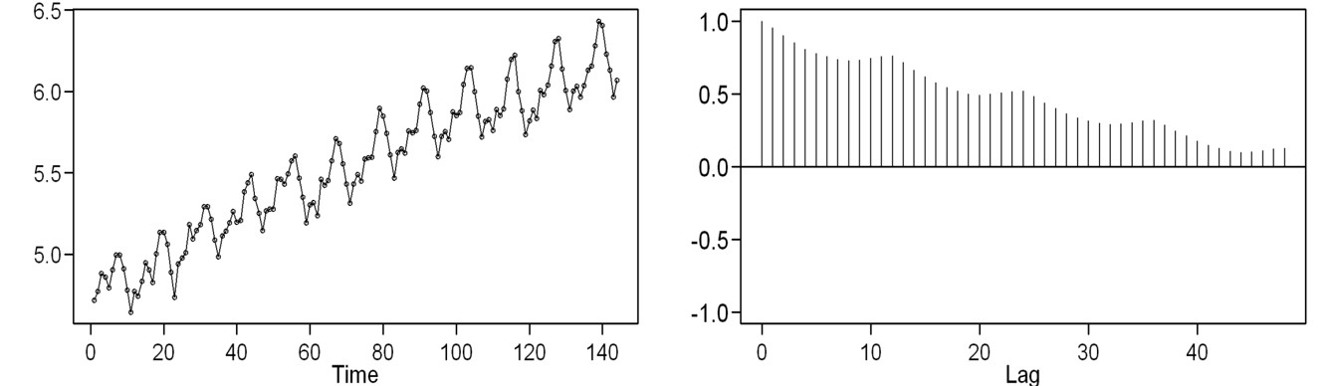
Log Airline Data
Data
Sample autocorrelations
Recall: We previously fit the model
$\left(1−B\right)\left(1−B^{12}\right)ϕ_{12}\left(B\right)\left(X_{t}−5.54\right)=\left(1−.45B\right)a_{t}$ ${\hat{σ}}_{a}^{2}=.0013$
$$_{12}\left(B\right)=1−.008B−.080B^{2}+.107B^{3}+.021B^{4}−.080B^{5}−.041B^{6} \\ +.055B^{7}−.036B^{8}−.133B^{9}+.053B^{10}+.0123B^{11}+.403B^{12}$$

Slide 35
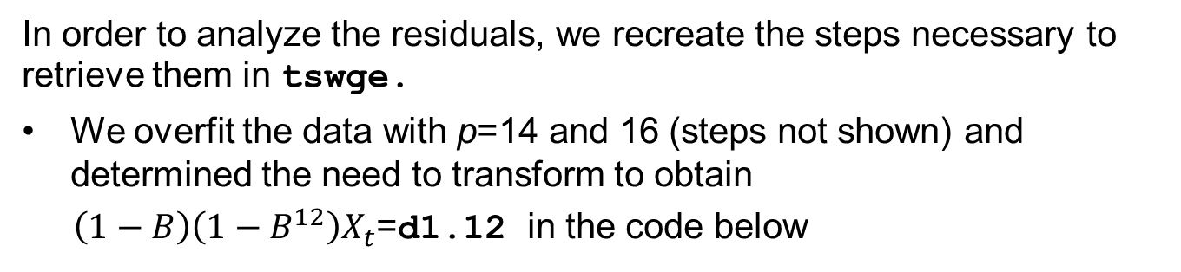
Log Airline Data
In order to analyze the residuals, we recreate the steps necessary to retrieve them in tswge.
We overfit the data with p=14 and 16 (steps not shown) and determined the need to transform to obtain
$\left(1−B\right)\left(1−B^{12}\right)X_{t}$=d1.12 in the code below
data(airlog)
# transform data
# Difference the data
d1=artrans.wge(airlog,phi.tr=1)
# Transform differenced data by 1-B^12
s12=c(0,0,0,0,0,0,0,0,0,0,0,1)
d1.12=artrans.wge(d1,phi.tr=s12)
aic.wge(d1.12,p=0:15,q=0:3)
# aic and aicc pick ARMA(12,1)
# estimate parameters of stationary part
est.12.1=est.arma.wge(d1.12,p=12,q=1)

Slide 36
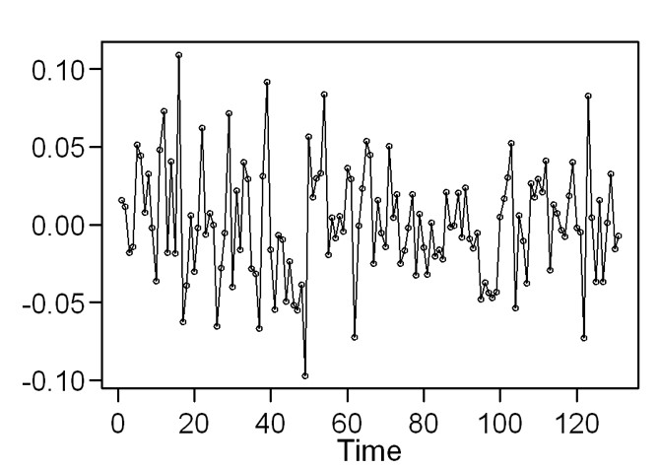
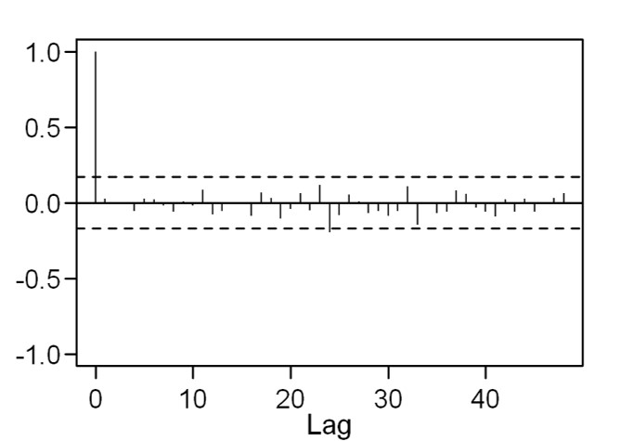
Log Airline Model: Analysis of Residuals
The code on the previous slide produces the fitted model obtained earlier.
The residuals are in est.12.1$res
Check 1: Examine residuals and their sample autocorrelations
Residuals
Residual sample autocorrelations
Residuals look “fairly white” (unusual behavior between 65-100)
Residual sample autocorrelations within 95% limit lines

Slide 37
Log Airline Model: Analysis of Residuals
Check 2: Ljung-Box test
As with the previous example, p and q for the Ljung-Box test are those obtained when fitting a stationary model to the transformed data. (in this case p=12, q=1)
ljung.wge(est.12.1$res,p=12,q=1)
# $K: 24 (default)
# $chi.square: 17.30648
# $df: 11
# $pval: 0.09913114
ljung.wge(est.12.1$res,p=12,q=1,K=48)
# $K: 48
# $chi.square: 35.93309
# $df: 35
# $pval: 0.4245906

Slide 38
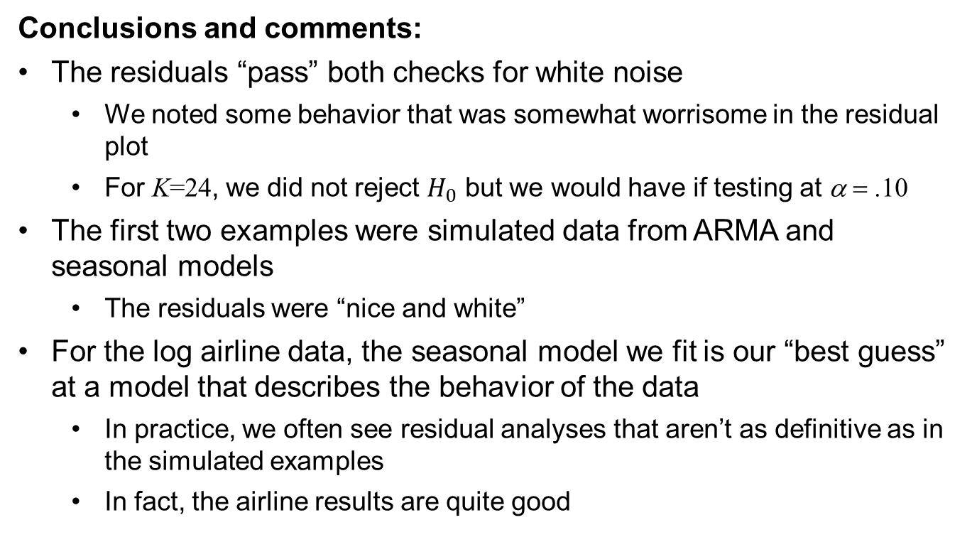
Log Airline Model: Analysis of Residuals
Conclusions and comments:
The residuals “pass” both checks for white noise
We noted some behavior that was somewhat worrisome in the residual plot
For K=24, we did not reject $H_{0}$ but we would have if testing at α = .10
The first two examples were simulated data from ARMA and seasonal models
The residuals were “nice and white”
For the log airline data, the seasonal model we fit is our “best guess” at a model that describes the behavior of the data
In practice, we often see residual analyses that aren’t as definitive as in the simulated examples
In fact, the airline results are quite good

Slide 40
Next Steps

Slide 41
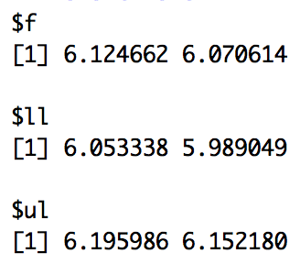
Next Step: Answer Questions of Interest
The question of interest may have been to forecast the number of airline passengers two months later and to quantify our uncertainty.
TwoMonthFore = fore.aruma.wge(airlog,d = 1, s = 12, phi = est.12.1$phi, theta = est.12.1$theta,n.ahead = 2, limits = TRUE)
TwoMonthFore
Conclusion: In two months we are 95% confident that the number of airline passengers will be between 399,415 (e^{5.99} * 1000) and 468,717 (e^{6.15} * 1000) passengers. Our best estimate is 432,681 (e^{6.07} * 1000) passengers.
Box = fore.aruma.wge(airlog,d = 1, s = 12, theta = c(.4,0,0,0,0,0,0,0,0,0,0,.6,-.24),n.ahead = 36,lastn = TRUE, limits = FALSE)
BOX_ASE = mean((airlog[(144-36+1):144] - Box$f)^2)
BOX_ASE
Woodward = fore.aruma.wge(airlog,d = 1, s = 12, phi = c(-.36,-.05,-.14,-.11,.04,.09,-.02, .02,.17,.03,-.10,-.38),n.ahead = 36,lastn = TRUE, limits = FALSE)
WOODWARD_ASE = mean((airlog[(144-36+1):144] - Woodward$f)^2)
WOODWARD_ASE
Parzen = fore.aruma.wge(airlog, d = 0, s = 12, phi = c(.74,0,0,0,0,0,0,0,0,0,0,.38,-.2812),n.ahead = 36,lastn = TRUE, limits = FALSE)
PARZEN_ASE = mean((airlog[(144-36+1):144] - Parzen$f)^2)
PARZEN_ASE

Slide 43
More Checks for Model Appropriateness

Slide 44
Does the model make sense?
Another important check for model appropriateness
Stationary vs. nonstationary
Seasonal vs. non-seasonal
Correlation-based vs. signal-plus-noise model
Are characteristics of fitted model consistent with those of the data
Forecasts and spectral estimates make sense?
Do realizations and their characteristics behave like the data?

Slide 46
Stationary Model
Global Temperature Data

Slide 47
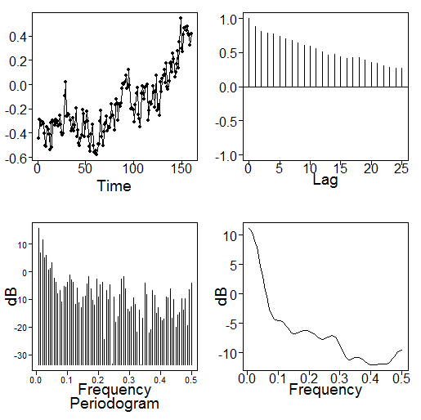
Modeling Global Temperature Data
Temperature data
Sample autocorrelations
Fitting a stationary model to the data:
data(hadley)
mean(hadley) # -0.1684937
plotts.sample.wge(hadley)
aic5.wge(hadley,p=0:6,q=0:1)
# AIC picks an ARMA(3,1) stationary model
had.est=est.arma.wge(hadley,p=3,q=1)
# $phi: 1.2700171 -0.4685313 0.1911988
# $theta: 0.6322319
# $avar: 0.01074178

Slide 48
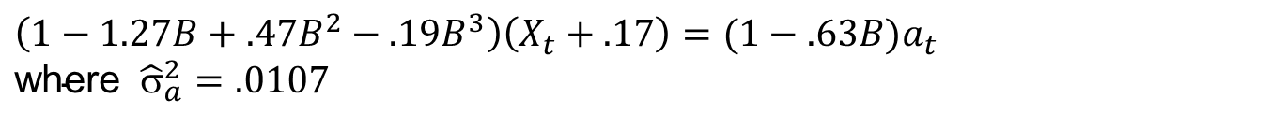
Stationary model:
Fitted ARMA(3,1) model
$$\left(1−1.27B+.47B^{2}−.19B^{3}\right)\left(X_{t}+.17\right)={(1−.63B)a}_{t} \\ {\text{where} \hat{σ}}_{a}^{2}=.0107$$
or in factored form
$$\left(1−.99B)(1−.28B+.19B^{2})\right)\left(X_{t}+.17\right)={(1−.63B)a}_{t}$$
(this is a “nearly nonstationary” model)

Slide 49
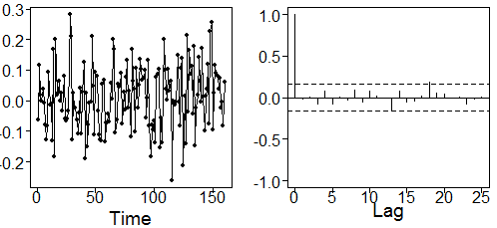
Stationary model:
Check residuals
plotts.sample.wge(had.est$res,arlimits=TRUE)
ljung.wge(had.est$res,p=3,q=1)
ljung.wge(had.est$res,p=3,q=1,K=48)
Sample autocorrelations of residuals
Residuals
Residuals look “white” and residual sample autocorrelations stay sufficiently within 95% limit lines
Ljung-Box results
P-values for K=24 and K=48 are 0.42 and 0.41, respectively.
Conclusion: Residuals for stationary ARMA(3,1) fit appear to be white.

Slide 50
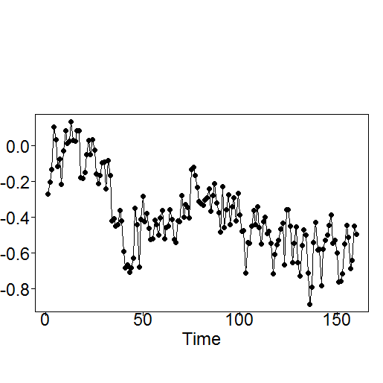
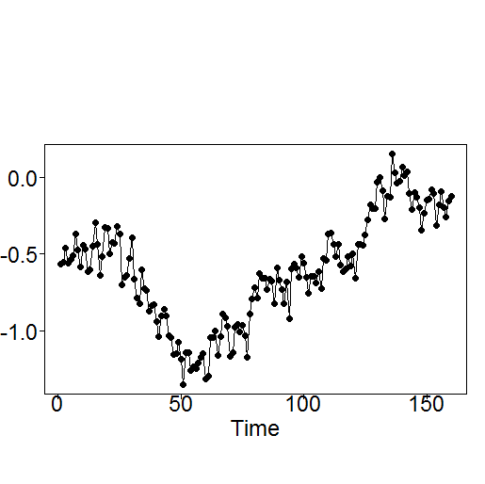
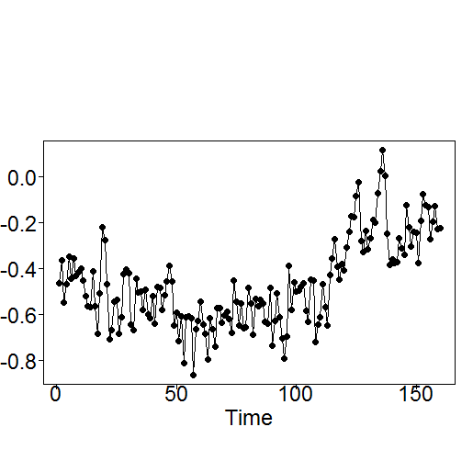
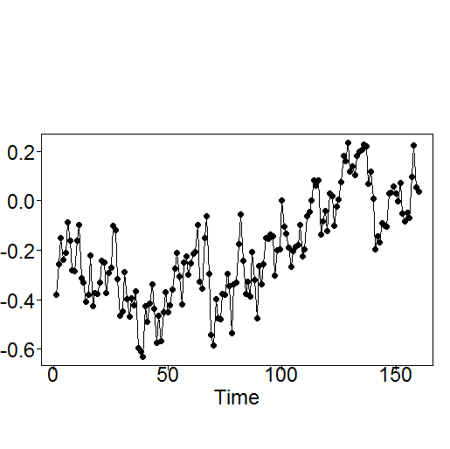
Stationary model:
Realizations
Does the ARMA(3,1) model produce realizations that “look like” the temperature data?
Realizations below were generated from the ARMA(3,1) model
They have the same general behavior as temperature data

Slide 52
Nonstationary Model
Global Temperature Data

Slide 53
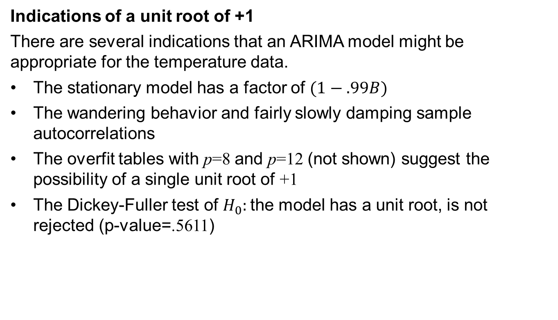
Nonstationary model fit to temperature data:
Indications of a unit root of +1
There are several indications that an ARIMA model might be appropriate for the temperature data.
The stationary model has a factor of $(1−.99B)$
The wandering behavior and fairly slowly damping sample autocorrelations
The overfit tables with p=8 and p=12 (not shown) suggest the possibility of a single unit root of +1
The Dickey-Fuller test of $H_{0}:$the model has a unit root, is not rejected (p-value=.5611)

Slide 54
Nonstationary model fit to temperature data:
Suppose that based on the evidence on the previous slide we make the decision to fit an ARIMA model to the temperature data
(Even though the model checks: white noise residuals, realizations that have the appearance of the data, etc. were good for the ARMA model)
In this case we proceed by differencing the hadley data.

Slide 55
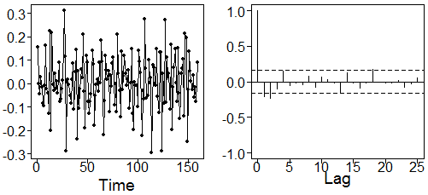
Nonstationary model fit to temperature data:
tswge code to difference the data
d1.temp=artrans.wge(hadley,phi.tr=1)
plotts.sample.wge(d1.temp,arlimits=TRUE)
Sample autocorrelations of differenced data
Differenced data
The differenced data appear to be stationary
And nearly “white”
However, the fact that the first two sample autocorrelations are outside the limits lines suggests that we continue to model

Slide 56
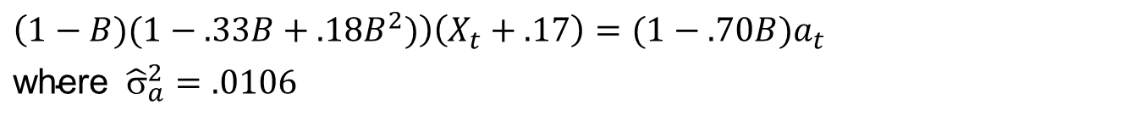
Nonstationary model fit to temperature data:
tswge code to model the differenced data
aic5.wge(d1.temp,p=0:6,q=0:1)
# AIC selects an ARMA(2,1)
d1.temp.est=est.arma.wge(d1.temp,p=2,q=1)
# $phi: 0.3274341 -0.1786827
# $theta: 0.704618
$avar: 0.01058826
Fitted ARIMA(2,1,1) model
$\left(1−B)(1−.33B+.18B^{2})\right)\left(X_{t}+.17\right)={(1−.70B)a}_{t}$
${\text{where} \hat{σ}}_{a}^{2}=.0106$

Slide 57
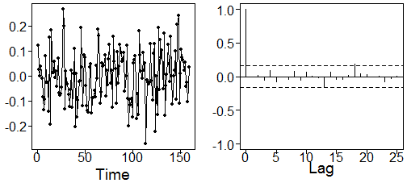
Nonstationary model fit to temperature data:
Check residuals
plotts.sample.wge(d1.temp.est$res,arlimits=TRUE)
ljung.wge(d1.temp.est$res,p=2,q=1)
ljung.wge(d1.temp.est$res,p=2,q=1,K=48)
Sample Autocorrelations of Residuals
Residuals
Residuals look “white” and residual sample autocorrelations stay sufficiently within 95% limit lines
Ljung-Box results
P-values for K=24 and K=48 are 0.47 and 0.58, respectively.
Conclusion: Residuals for stationary ARMA(2,1) fit appear to be white.

Slide 58
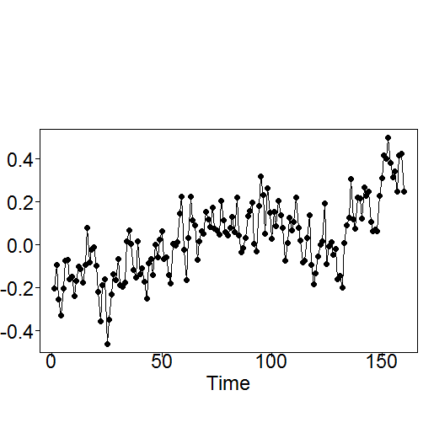
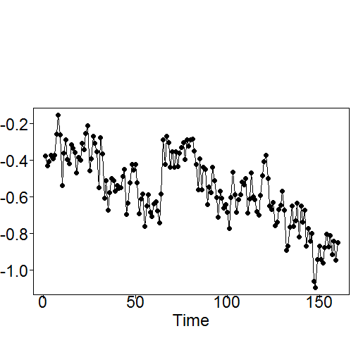
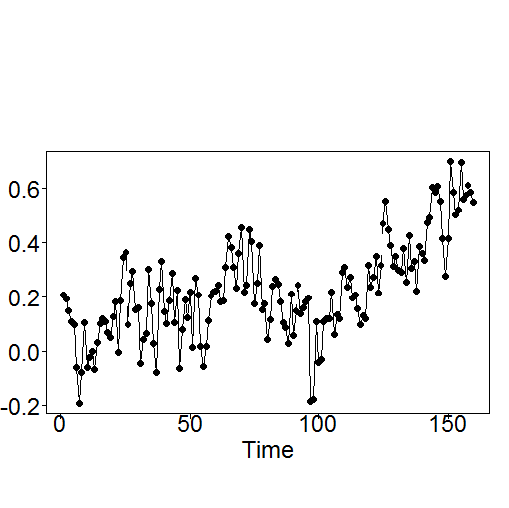
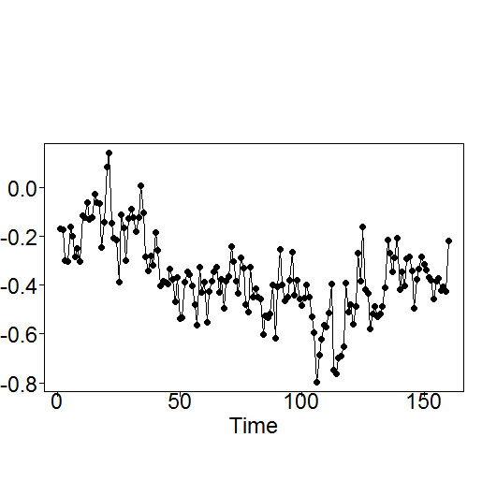
Nonstationary model fit to temperature data:
Realizations
Does the ARIMA(2,1,1) model produce realizations that “look like” the temperature data?
Realizations below were generated from the ARMA(3,1) model
They have same general behavior as temperature data

Slide 59
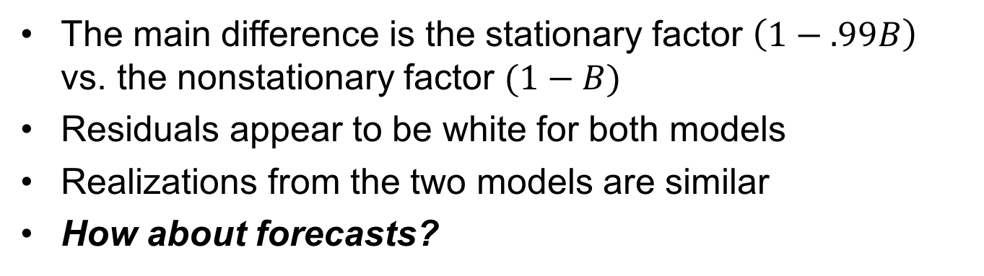
Stationary ARMA(3,1) vs. ARIMA(2,1,1) Fit to Temperature Data
Clearly: The two models are quite similar to each other.
Stationary model
$$\left(1−.99B)(1−.28B+.19B^{2})\right)\left(X_{t}+.17\right)={(1−.63B)a}_{t}$$
Nonstationary model
$\left(1−B)(1−.33B+.18B^{2})\right)\left(X_{t}+.17\right)={(1−.70B)a}_{t}$
The main difference is the stationary factor $\left(1−.99B\right)$ vs. the nonstationary factor $(1−B)$
Residuals appear to be white for both models
Realizations from the two models are similar
How about forecasts?

Slide 60
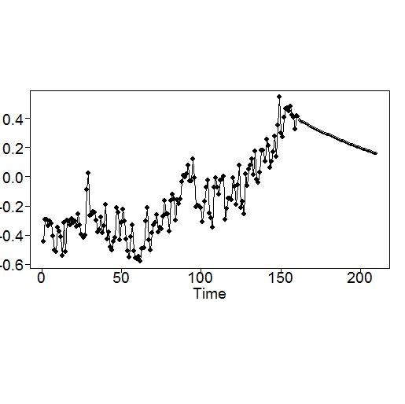
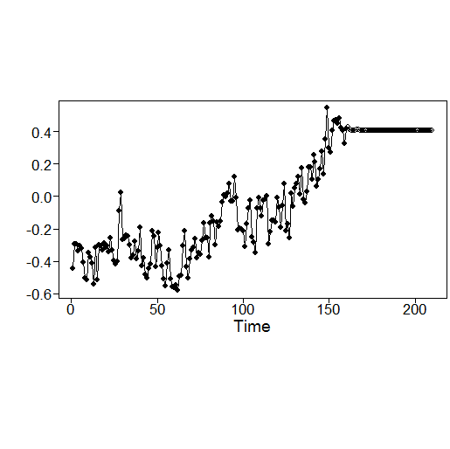
Forecasts using stationary model
data(hadley)
fore.arma.wge(hadley,phi=c(1.27,-.47,.19), theta=.63,n.ahead=50,limits=FALSE)
Forecasts using nonstationary model
fore.aruma.wge(hadley,d=1,phi=c(.33,-.18), theta=.7,n.ahead=50,limits=FALSE)

Slide 61
Notes:
The two “similar” models produce very different forecasts
It is important to understand the properties of the selected model
The selection of a stationary model will automatically produce forecasts that eventually tend toward the mean of the observed data
Forecasts from the ARIMA(2,1,1) model will tend to a horizontal line at about the level of the last data value.
That is: It was the decision to use an ARMA or ARIMA model that resulted in the forecasts produced
Beware of results by analysts who choose a model in order to produce desired results

Slide 62
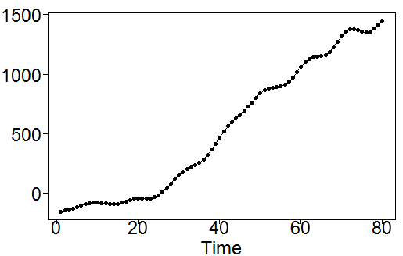
Note: For the temperature data, the debate centers around whether we should predict the trend to continue.
For “correlation-based” models:
In order for a trend to be predicted to continue we need 2 unit roots.
We did see this in the airline data
In the non-seasonal case, realizations from models with 2 unit roots often look like
Highly correlated wandering pattern – much more so than the temperature data
The choice of a correlation based model makes it difficult to conclude that we should predict a trend to continue

Slide 63
Caution: The decision concerning whether the observed warming trend should be predicted to continue is one that involves a variety of climatological issues we are not discussing here.
We simply ask the question:
Given reasonable models fit to the historical data, would these models predict the current trend to continue?
The answer is “No” based on the standard ARMA and ARIMA fits to the temperature data
Which seem like reasonable models and easily passed the checks for white noise residuals, etc.
So, is there any statistical argument for claiming the trend should continue?

Slide 65
Signal-Plus-Noise Model
Global Temperature Data

Slide 66

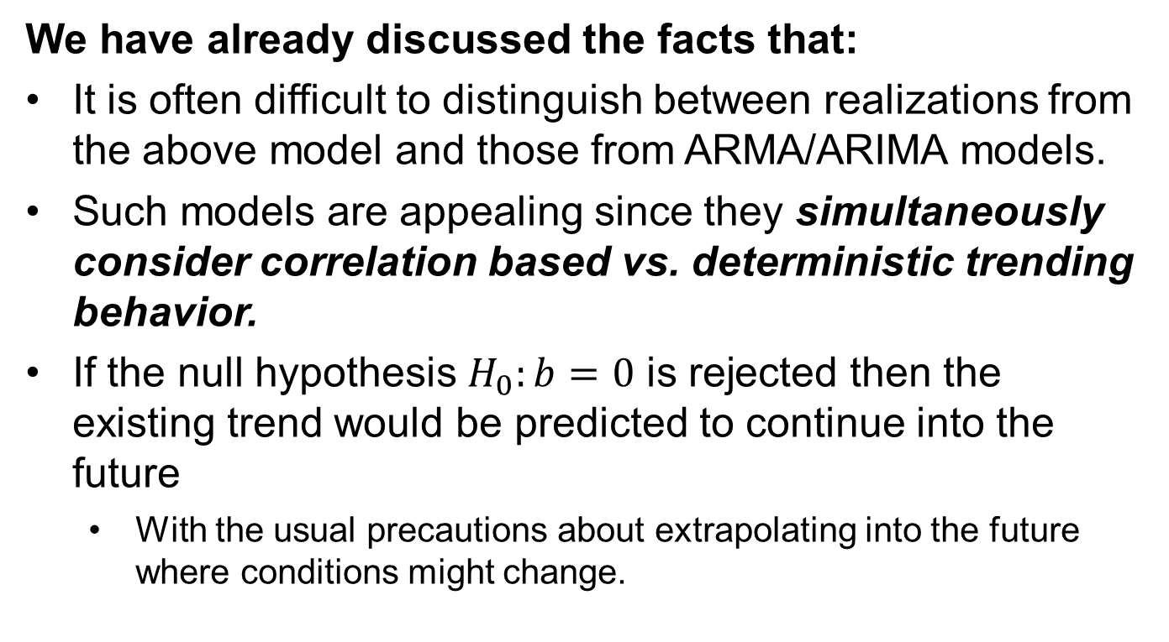
Let’s consider the signal-plus-noise model: $$X_{t}=a+bt+Z_{t}$$
We have already discussed the facts that:
It is often difficult to distinguish between realizations from the above model and those from ARMA/ARIMA models.
Such models are appealing since they simultaneously consider correlation based vs. deterministic trending behavior.
If the null hypothesis $H_{0}:b=0$ is rejected then the existing trend would be predicted to continue into the future
With the usual precautions about extrapolating into the future where conditions might change.

Slide 67
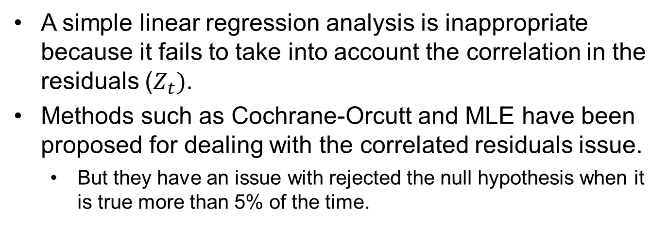
Fitting Signal-Plus-Noise Models
When testing $H_{0}:b=0$ we noted that:
A simple linear regression analysis is inappropriate because it fails to take into account the correlation in the residuals ($Z_{t})$.
Methods such as Cochrane-Orcutt and MLE have been proposed for dealing with the correlated residuals issue.
But they have an issue with rejected the null hypothesis when it is true more than 5% of the time.
However: For purposes of this example, we will use the Cochrane-Orcutt procedure for testing for trend in the temperature data set.

Slide 68
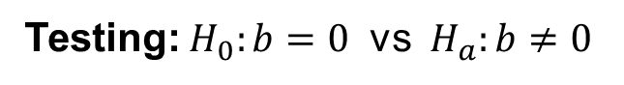

Signal-plus-noise model fit to temperature data: testing b (slope) with Cochrane-Orcutt
Model: $X_{t}=a+bt+Z_{t}$
Testing: $H_{0}:b=0$ vs ${ H}_{a}:b≠0$
The following R code provides a Cochrane-Orcutt test for the temperature data
Fit a regression line to the data and find the residuals from the line
x=hadley
n=length(x)
t=1:n
d=lm(x~t)
x.z=x-d$coefficients[1]-d$coefficients[2]*t
#x.z are the residuals from the regression line

Slide 69
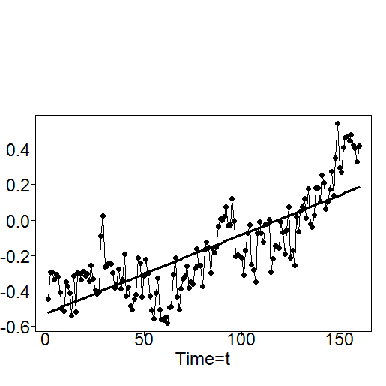
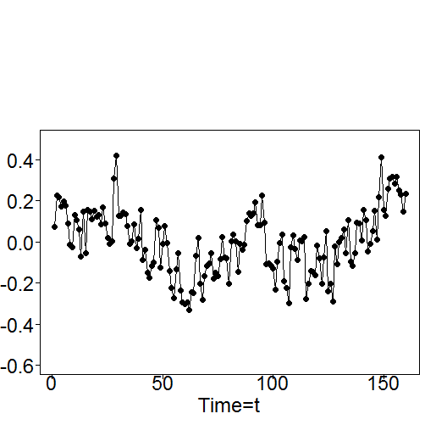
Signal-plus-noise model fit to temperature data: using Cochrane-Orcutt
Below are plotted the Hadley temperature data and residuals from the regression line
Hadley
Residuals from regression line
The trending behavior is mostly removed in the residuals but there is still substantial autocorrelation
i.e. correlated residuals

Slide 70
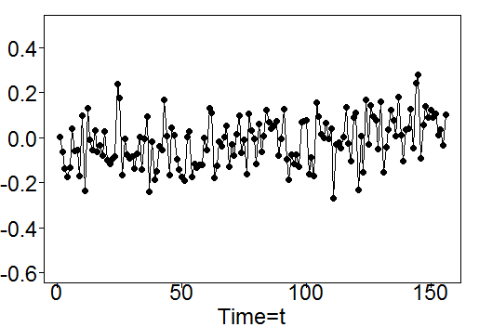
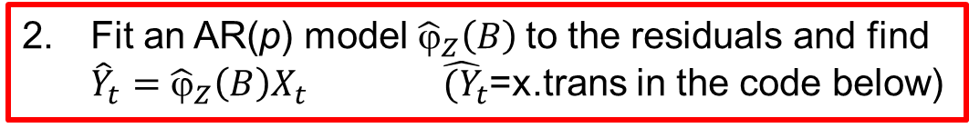
Signal-plus-noise model fit to temperature data: using Cochrane-Orcutt
Fit an AR(p) model ${\hat{ϕ}}_{Z}\left(B\right)$to the residuals and find ${\hat{Y}}_{t}={\hat{ϕ}}_{Z}\left(B\right)X_{t}$ ${\hat{(Y}}_{t}$=x.trans in the code below)
ar.z=aic.wge(x.z,p=0:6)
# ar.z$p is the order p
#ar.z$phi is vector of ar.z$p estimated AR coefficients
x.trans=artrans.wge(hadley,phi.tr=ar.z$phi)
x.trans (plotted against time t)

Slide 71
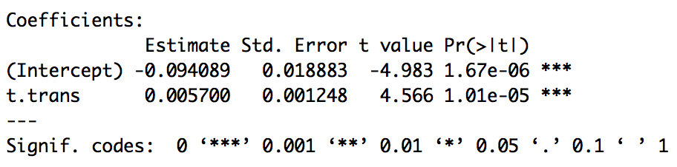
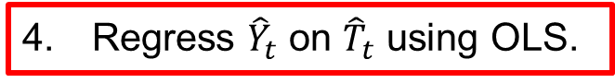
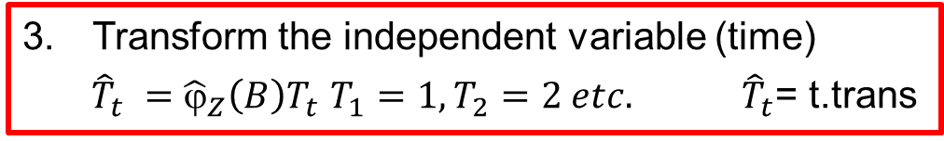
Signal-plus-noise model fit to temperature data: using Cochrane-Orcutt
Transform the independent variable (time)
${\hat{T}}_{t} ={\hat{ϕ}}_{Z}\left(B\right)T_{t}$ $T_{1}=1,T_{2}=2 etc. {\hat{T}}_{t}$= t.trans
#ar.z$phi is vector of ar.z$p estimated AR coefficients
t.trans=artrans.wge(t,phi.tr=ar.z$phi)
Regress ${\hat{Y}}_{t}$ on ${\hat{T}}_{t}$ using OLS.
fit = lm(y.trans~t.trans)
summary(fit)
After accounting for the serial correlation (AR(4)), there is strong evidence to suggest that the slope is significantly different from zero (pvalue < .0001).
Conclusion: Cochrane-Orcutt clearly concludes there is a significant slope (p-value<.001)

Slide 72

Signal-plus-noise model fit to temperature data: using Cochrane-Orcutt
Evaluating residuals (after Cochrane–Orcutt)
plot(fitco$residuals)
acf(fitco$residuals)
ljung.wge(fitco$residuals)
Residuals from transformed fit
Sample autocorrelations of residuals
Sample autocorrelations tend to stay within limit lines and Ljung-Box test has p-values of .805 and .577 for K=24 and 48 respectively.

Slide 73

Signal-plus-noise model fit to temperature data: using Cochrane-Orcutt
Estimated signal-plus-noise model
$X_{t}=−.5257+.0044t+Z_{t}$ where ${\hat{σ}}_{a}^{2}=.0103$
$$\left(1−.614B+.044B^{2}−.078B^{3}−.026B^{4}\right)Z_{t}=a_{t}$$
or $(1−.92B)(1−.21B+.43B^{2})(1+.52B){Z_{t}=a}_{t}$
Note 1: The above is the signal-plus-noise fit to the temperature data. Cochrane-Orcutt is a procedure to assess the significance of the slope (adjusting for the correlated errors).
Note 2: We had to code the Cochrane-Orcutt Procedure manually since the function cochrane.orcutt() is only for AR(1) correlation.

Slide 74




Signal-plus-noise model fit to temperature data: using Cochrane-Orcutt
Evaluating realizations from fitted model
$X_{t}=−.5257+.0044t+Z_{t}$ , ${\hat{σ}}_{a}^{2}=.0103,$ and $Z_{t}$ is AR(4)
Realizations have the appearance of temperature data
All tend to increase because of the line with positive slope
gen.sigplusnoise.wge(160, b0 = -.5257, b1 = .0044, phi = ar.z$phi, vara = .0103)

Slide 75

Forecasts using Signal-Plus-Noise Model
data(hadley)
fore.sigplusnoise.wge(hadley,max.p=4,n.ahead=50,limits=FALSE)
Interestingly, the forecasts suggest an initial decline but eventually predict the trend to continue

Slide 77
Final Thoughts on Temperature Data

Slide 78
Important Points
Realizations from AR (ARMA/ARUMA) models have random trends
Unless there are 2 unit roots, these models will not forecast a trend to continue
Realizations from X_{t} = S_{t} + Z_{t} have deterministic trends
If conditions do not change, then these trends will be forecast to continue
Regarding the temperature data, if there is a deterministic signal in the data, it almost assuredly is not simply a straight line

Slide 79
Final Thoughts for Temperature Data
All three models (ARMA, ARIMA, and signal-plus-noise) seemed to be satisfactory models from the standpoint of
Residual analysis
Realizations generated
However, the three produced strikingly different forecasts
Knowledge of the physical situation can help guide you, incorrect assumptions may lead you to the wrong conclusion
We can’t stress enough:
Beware of results by analysts who choose a model in order to produce desired results

Slide 81
General Comments about Forecasts
ARMA and ARIMA forecasts may seem “boring” in that they often will not forecast seemingly obvious behavior to continue
However, if assumptions are met so that an ARMA or ARIMA model are the appropriate models, then the forecasts are “cautious and wise”
The behavior may be of a random nature and may not hold up
Forecasts that largely depend on a deterministic trend may “look” better but they expose you to the usual cautions about extrapolation
In all cases, short term forecasts are more reliable
Which is illustrated by ever widening prediction limits

Slide 83
More on Model Appropriateness
Sunspot Data

Slide 84

Sunspot Data: 1749-1924 (sunspot.classic)
Sunspot data
Sample autocorrelations
Parzen spectral density

Slide 85
Note: This is a classic and often analyzed time series data set.
It is in data file sunspot.classic in tswge
Box and Jenkins modeled the data in their textbook using the “Box-Jenkins” approach mentioned earlier
We will consider the problem of modeling these data and checking model appropriateness

Slide 86
Some Final Comments on Checking Models for Appropriateness
We have briefly discussed the issue of checking models to see if they produce realizations that “behave like the original data.” In general, we may also want to check whether generated realizations:
Have sample autocorrelations similar to those for the actual data?
Have spectral densities that are similar to those for the data?
Let’s investigate further using the classic sunspot data (sunspot.classic in tswge).

Slide 88
Sunspot Data
Box-Jenkins Model

Slide 89

Sunspot Data: Box-Jenkins Model
The Box-Jenkins procedure involves plotting the sample autocorrelations and sample partial autocorrelations and looking for patterns
Sample autocorrelations and partial autocorrelations can be obtained using base R functions
acf(sunspot.classic)
pacf(sunspot.classic)
Sample autocorrelations
Partial autocorrelations
The two large partial autocorrela-tions strongly suggest an AR(2)

Slide 90

Sunspot Data: Box-Jenkins Model
Box and Jenkins fit an AR(2) model to the data. Using MLE estimates for the AR(2) we obtain
s2=est.ar.wge(sunspot.classic,p=2)
# s2$phi: 1.3347282 -0.6474423
# s2$avar:235.993
mean(sunspot.classic) # 44.78409
$\left(1−1.33B+.65B^{2}\right)\left(X_{t}−44.78\right)=a_{t} {\text{where} \hat{σ}}_{a}^{2}=236$
Factor Abs recip System freq
1-1.3347B+0.6474B^2 0.8046 0.0943
The factor table shows that this model is associated with a pseudo-cyclic behavior with frequency $f_{0}=.094$ or cycle length 1/.094=10.6 years which is consistent with the data.

Slide 91


Sunspot Data: Box-Jenkins Model
AR(2) residuals
Residual autocorrelations
The residuals look reasonably white
Sample autocorrelation of the residuals stay within the 95% limit lines
Ljung-Box did not reject the null of white noise at K=48 (p-value=.21) but at K=48 (p-value=.05) the conclusion of white noise is somewhat questionable

Slide 93
Sunspot Data
AIC Model

Slide 94

Sunspot Data: AIC Model Selection
We next let AIC select a model for the sunspot data. We have chosen to select the best AR model using the code below:
aic5.wge(sunspot.classic,p=0:10,q=0:0)
# AIC picks an AR(8)
# FYI BIC selects an AR(2)
s8=est.ar.wge(sunspot.classic,p=8)
# s8$phi: 1.22872595 -0.47331327 -0.13807811 0.15688938 -0.14030802 0.07050449 -0.12841889 0.20692558
# s8$avar:212.6003
mean(sunspot.classic) # 44.78409
The resulting AR(8) model selected by AIC is:
$\left(1−1.23B+.47B^{2}−.14B^{3}−.16B^{4}+.14B^{5}−.07B^{6}+.13B^{7}−.21B^{8}\right)\left(X_{t}−44.78\right)=a_{t} {\text{where} \hat{σ}}_{a}^{2}=213$

Slide 95
Sunspot Data: AIC Model Selection
The factor table shown below also has a dominant frequency associated with the 10.5 year period.
Factor Abs recip System freq
1-1.5565B+0.8970B^2 0.9471 0.0965
1-0.8771B 0.8771 0.0000
1-0.4147B+0.6550B^2 0.8093 0.2088
1+0.7964B 0.7964 0.5000
1+0.8231B+0.5043B^2 0.7101 0.3484

Slide 96


Sunspot Data: AIC Model Selection
$\left(1−1.23B+.47B^{2}−.14B^{3}−.16B^{4}+.14B^{5}−.07B^{6}+.13B^{7}−.21B^{8}\right)\left(X_{t}−44.78\right)=a_{t} {\text{where} \hat{σ}}_{a}^{2}=213$
AR(8) residuals
Residual autocorrelations
Again, the residuals look reasonably white
Sample autocorrelation of the residuals stay within the 95% limit lines
Ljung-Box did not reject the null of white noise at K=24 or at K=48 with p-values of .33 and .24, respectively

Slide 98
Sunspot Models
Comparing Realizations

Slide 99

Sunspot Models: Comparing Realizations
Sunspot data
Realizations from the AR(2) model
Realizations from the AR(8) model

Slide 100
Sunspot Models: Comparing Realizations
Clearly neither model produced realizations that were very similar to the sunspot data
The sunspot data has an asymmetric appearance in which the peaks are more variable than the troughs
The AR models produce no such asymmetry
Might need nonlinear models not covered here
Also, the cyclic behavior holds together stronger in the sunspot data than in the realizations from the two models
Although the cycles may tend to hold up better in the AR(8) realizations

Slide 102
Sunspot Models
Comparing Autocorrelations

Slide 103
Sunspot Models: Comparing Autocorrelations
Sunspot data
Dark curve shows sunspot autocorrelations
4 other curves in each plot are the sample autocorrelations from the realizations
AR(2) model
AR(8) model
AR(8) autocorrelations track the sunspot autocorrelations much better

Slide 105
Sunspot Models
Comparing Spectral Densities

Slide 106
Sunspot Models: Comparing Spectral Densities
Peak at zero has to do with wandering behavior of peak sizes
Sunspot data
4 other curves in each plot are the spectral densities from the realizations
Dark curve shows sunspot spectral density
AR(2) model
AR(8) model
AR(8) spectral densities do a better job of showing a peak at f=0 (AR(2) model only has one peak in its true spectral density).

Slide 108
Sunspot Models
Comparing Forecasts

Slide 109




Sunspot Models: Comparing Forecasts
Forecast next 50
These look better than AR(2)
AR(2)
AR(8)
Forecast last 50
Forecast peak at a trough!
AR(2)
AR(8)
Oops!

Slide 111
Sunspot Models
Summary

Slide 112
Sunspot Models: Summary
The AR(8) model seemed superior to the AR(2) model picked using partial autocorrelations
White noise test more conclusive
More similar sample autocorrelations
More similar spectral densities that tended to show the peak at zero in the sunspot spectral density
Forecasts pick up the cyclic behavior better
But forecasts of last 50 years got “off cycle”
Sunspot cycle length varies some from cycle to cycle (pseudo periodic)
Be careful about long term forecasts!
BONUS: Check Out: https://spaceplace.nasa.gov/solar-cycles/en/

Slide 114
Note to Students

Slide 115
Note
Previous discussion only focused on deciding among
ARMA(p,q)
ARIMA(p,d,q)
Signal-plus-noise
There are many other models and tools available to the time series analyst, among which are:
Multivariate models
Long memory models
ARCH/GARCH models (useful with economic data)
Neural networks... We will study these soon!

Slide 117
Extras

Slide 118
Signal-plus-noise model fit to temperature data: using R function arima
A maximum likelihood approach
data(hadley)
t=1:length(hadley)
arima(hadley,order=c(4,0,0),xreg=t)
Coefficients:
ar1 ar2 ar3 ar4 intercept t
0.6140 -0.0440 0.0776 0.2064 -0.5183 0.0046
s.e. 0.0774 0.0914 0.0914 0.0779 0.0950 0.0010
sigma^2 estimated as 0.01036: log likelihood = 137.98, aic = -261.96
Note:
These are very close to the Cochrane-Orcutt results
We will discuss the use function arima using option xreg in the next unit in the context of multiple regression with correlated errors
This approach also has the problem with inflated significance levels

